Slide 1
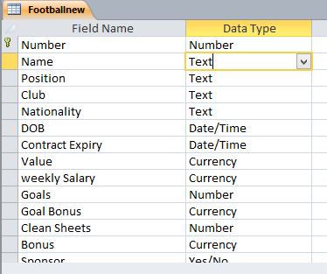
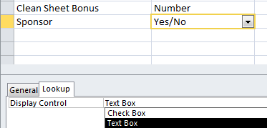
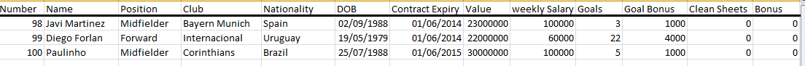
1) Using a suitable database package (Access), import the file Footballnew.CSV (Data Format – Day/Month/Year) Assign the following data types to the fields: Each player will have a unique number (1-100). Set the number as the primary key.
2) Some Players have transferred to new clubs. Please update the following Records
3) Please add the following three records to your database (Enter no for all sponsors)
Primary Key
13. Neymar (New club – Barcelona) 17. Mesut Ozil (New club – Arsenal) 26. William (New club – Chelsea) | 34. Mario Gotze (New club – Bayern Munich) 38. Fernandinho (New club – Man City) 40. Gareth Bale (New club – Real Madrid)

